Slide 1
TDR proximity sensors
How to evaluate the distance between the robot and an obstacle?

Slide 2
1 - Inputs
In order to be “homologable”, our robot must be able to detect the other robot to avoid collisions.
Moreover, it can be useful to measure the distance to other obstacles (edge of the table for instance).
We need a fast detection system, able to detect obstacles and measure their distance, especially when this distance is small.

Slide 3
2 - Analysis
In order to be reactive, we cannot rely on the camera (because of communication delays). We then need to use an embedded detection system.
We choose to use distance sensors that will measure the distance to the nearest obstacle in a given direction. We will place 3 of them in front of the robot, so it can detect an incoming obstacle when it rolls.
Direction
“forwards”

Slide 4
2 - Analysis
It can also be relevant to have a distance sensor facing backwards. This one doesn’t have the same function : it shall not detect an unexpected obstacle (robot), but it shall measure the distance to a wall.
In effect, many teams in the Robotics Cup use walls to reposition their robot during the match. We will perhaps adopt this technique, and in this case we can use another sensor to hit the wall very slowly (in order to avoid damaging our robot).
Votre robot doit etre capabe de shooter le mur à pleine vitesse, ca lui arrivera ☺
De mon expérience, on se recalait en s’appuyant sur le mur, sans utiliser de detecteur de « je suis proche ». A la rigueur, deux interrupteurs de chaque coté pour vérifier qu’on est bien en train d’appuyer a plat sur le mur, et y’a pas un objet qui bloque.

Slide 5
2 - Analysis
There are two main sensor families : infrared and ultrasound, each of them having their advantages and drawbacks :
 | Infrared | Ultrasound
Precision | The precision of the measurement is slightly better
Directivity of the signal | More directive : less perturbation because of the ground or other obstacles. | Less directive : easier to detect obstacles which are not exactly in front of the sensor.
Interference | Can be disturbed by an IR sensor of the other robot (unlikely because of the directivity of the ray) or by the autofocus of cameras. | Can be easily disturbed by another ultrasound sensor if the frequency is the same.

Slide 6
2 - Analysis
Last year, the team had used IR sensors from ST Microelectronics (VL53L0X), but we will not reuse their system, because of several reasons:
The communication between ST Microelectronics and Arduino is very complicated.
One ST card can not control more than 3 sensors at once (the system is not flexible).
Because of communication problems, the sensors could only deliver an distance coded on 4 bits to the Arduino card (16 different values), which is of course less precise than an analog output.

Slide 7
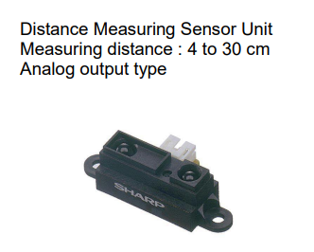
3- Solution
As a consequence of the previous analysis, we chose to use the infrared sensor SHARP GP2Y0A41SK0F below, with a measuring distance ranging from 4 to 30cm:

Slide 8
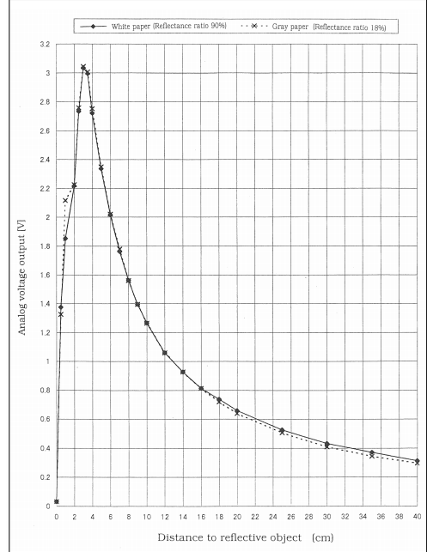
3- Solution
The sensor delivers an output voltage depending on the measured distance.
However, the voltage curve isn’t a bijective function, which means that a voltage value could correspond to 2 different distance measures which will be problematic.

Slide 9
3- Solution
To avoid the previous problem, we noticed that since the sensor had a bijective curve starting from a distance of 3cm, we can set the sensor about 3cm in the bottom of the robot instead of putting it stuck to its body as explained below:
The measured distances will now range from
0 to 27cm and this configuration acts as if
we put a bijective sensor with a measuring
distance 0 to 27cm.
3cm distance

